Slide 1
Youtube Content Monetization Model
Presented By
Manisha Priyadharsini M

Slide 2

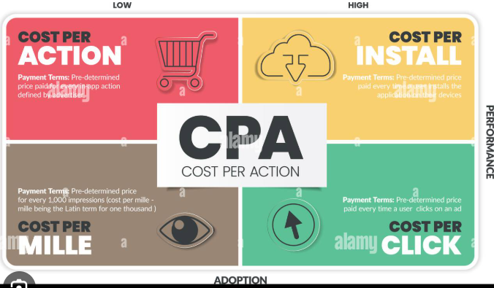
Creator Support tools

Slide 3
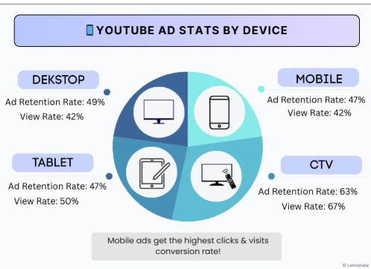
Devices

Slide 4
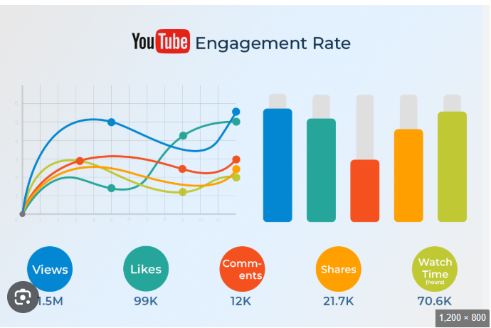
Engagement Rate

Slide 5
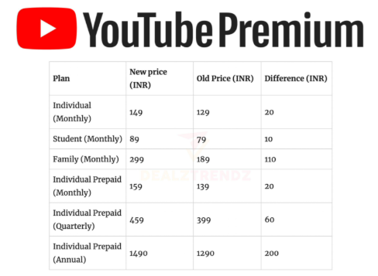
Subscription Rate

Slide 6
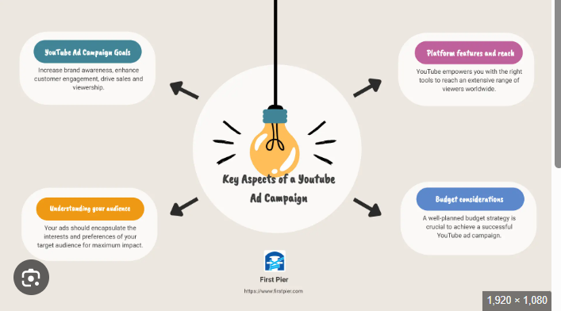
Ad Campaign Plan

